Slide 1
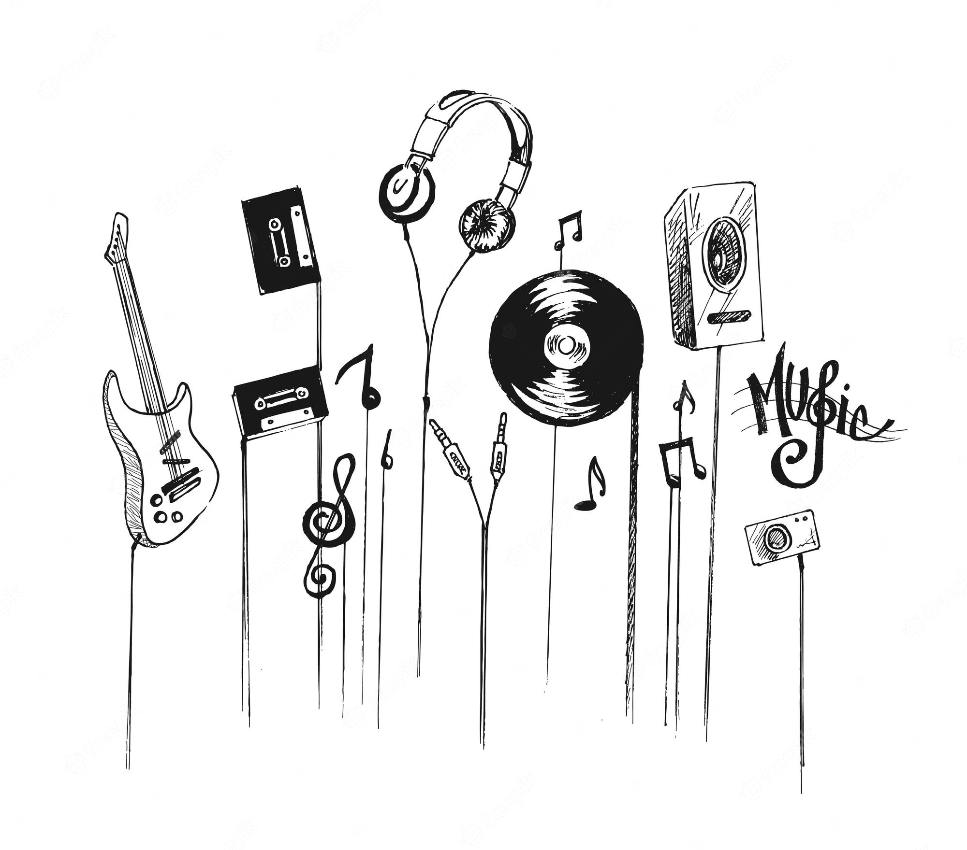

Music Genre Analysis
By:
Srivathsav Mitnala

Slide 2


Slide 3

Foundation
Every song has different features that helps categorize it as a specific genre
How important are these features?
What are the characteristics of each song?
Can we predict the genre of a song with these features?

Slide 4
Music is a creative impulse by an artist and every song has its own speciality
People have different tastes in music
This project is aimed at predicting the genre of a song based on its features

Slide 5

Data Exploration and Analysis
There different features to a song like acousticness, danceability,liveness, loudness etc.
First all of these fields were normalized to the same scale
Different categorical fields were one-hot encoded
NA values were taken care of and data anamolies were removed.

Slide 6
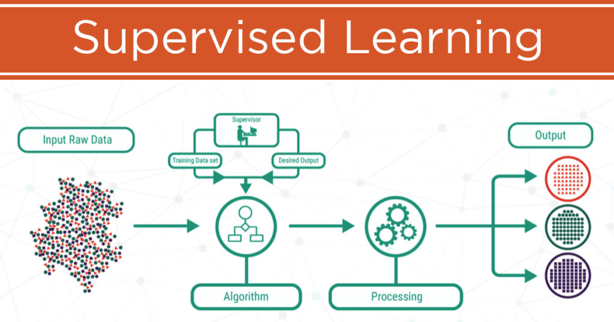

Slide 7
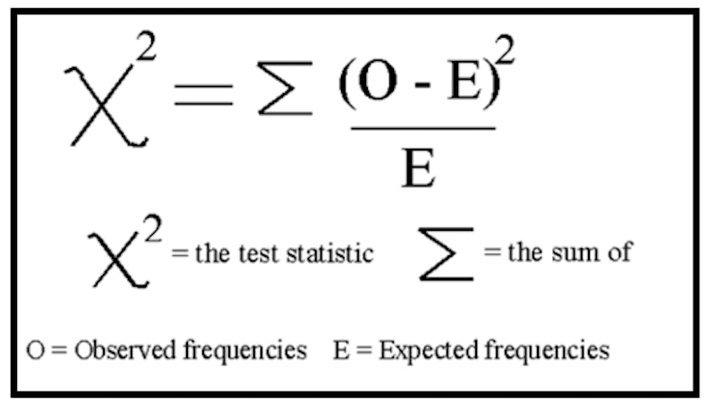
Classification
Random forest Classifier and Logistic Regression models were used for comparison of accuracies
First, the data was divided into features and target
The features were selected based on Chi-Squared test
The data was later divided into training and test sets

Slide 8

Model application and accuracies
Logistic regression and Random forest classification was applied using sklearn library in Python
Logistic Regression: 0.39
Random Forest: 0.42

Slide 9
Conclusions
Although these models are of high value, the accuracies are pretty low
One possible reason is to further analyze the data better and get it to the right state
However, for something of so much creative impulse, it is almost difficult to classify just based on different features, maybe data related to the sound of the music will help give a more accurate estimate.

Slide 10
Future Scope
Load more data onto User recently played tracks
Use sound from the music as part of the data and apply CNN models for better classification accuracies
Connect User recently played tracks to Music Genre data and get a more personalized analysis

